Slide 1
Agile Software Development
UNIT I
INTRODUCTION

Slide 2
UNIT–I: Introduction: The Agile manifesto, Agile methods, XP: Extreme Programming, DSDM, SCRUM, feature- Driven Development, modelling misconceptions, agile modelling, tools of misconceptions, updating agile models.
UNIT–II: Extreme Programming: Introduction, core XP values, the twelve XP practices, about extreme programming, planning XP projects, test first coding, making pair programming work
UNIT–III: Agile Modelling and XP: Introduction, the fit, common practices, modelling specific practices, XP objections to agile modelling, agile modelling and planning XP projects, XP implementation phase.
UNIT–IV: Feature-Driven Development: Introduction, incremental software development, Regaining Control,The motivation behind FDD, planning an iterative project, architecture centric, FDD and XP
UNIT–V: Agile Methods with RUP and PRINCE2 and Tools and Obstacles: Agile modelling and RUP, FDD and RUP, agile methods and prince2, tools to help with agile development, Eclipse, An agile IDE, obstacles to agile software development, management intransigence, the failed project syndrome, contractual difficulties, familiarity with agility

Slide 3
UNIT I
Introduction:
The Agile manifesto, Agile methods,
XP: Extreme Programming,
DSDM -Dynamic systems development method,
SCRUM ,
feature- Driven Development,
agile modelling
modelling misconceptions
tools of misconceptions
updating agile models

Slide 4
What Is Agile Methodology?
Agile means ‘the ability to move quickly and easily’ and respond to change rapidly
Agile methodology is a project management approach that prioritizes cross-functional collaboration and continuous improvement.
It divides projects into smaller phases and guides teams through cycles of planning, execution, and evaluation.

Slide 5
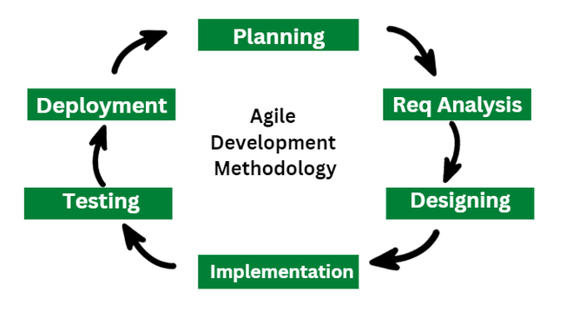

Slide 6
Agile vs Waterfall Methodology
Agile is like a good fit for projects that need to be flexible and change a lot, such as making computer programs.
It works well when talking with customers and making improvements bit by bit are really important.

Slide 7
On the other side, Waterfall is just right for projects that have
clear steps and simple, straight-ahead plans. It’s like following
a recipe step by step.
So, if your project is all about changes and surprises, go for Agile.
But if it’s more like following a clear plan without many surprises,
Waterfall is the way to go.

Slide 8
Agile Methodologies vs Traditional Approaches
Parameters | Agile Methodology | Traditional Approach
Definition | Agile is like building a flexible and adaptable treehouse in stages. | Traditional approaches are like constructing a house with a detailed blueprint.
Chronology of operations | Testing and development processes are performed concurrently. | Testing is done once the development phase is completed.
Organizational structure | It follows iterative organizational structure. | It follows linear organizational structure.
Communication | Agile encourages face-to-face communication. | Traditional approach encourages formal communication.
Number of phases | It consists of only three phases. | It consists of five phases.
Development cost | Less using this methodology. | More using this methodology.
User requirements | Clearly defined user requirements before coding. | Requires interactive user inputs.

Slide 9
Agile Manifesto
The Agile Manifesto for Software Development
put forth a ground-breaking mindset on delivering
value and collaborating with customers when it
was created in 2001.
Agile’s four main values are:
Individuals and interactions over processes and tools
Working software over comprehensive documentation
Customer collaboration over contract negotiation
Responding to change over following a plan

Slide 10
Based on these value statements, a set of 12 principles have been identified
Highest priority is to satisfy the customer.
Welcome change.
Deliver working software frequently.
Business people and developers must work together daily.
Build projects around motivated individuals.
Face-to-face communication is best.
Working software is the primary measure of progress.
Promote sustainable development.
Continuous attention to technical excellence and good design enhances agility.
Simplicity – the art of maximising the amount of work not done – is essential.
The best architectures, requirements and design emerge form self-organising teams.
Introspection – teams should regularly review itself and its processes to try and improve.

Slide 11
The advantages of the agile model are as follows:
Immediate Feedback: It allows immediate feedback, which aids software improvement in the next increment.
Adapts to Changing Requirements: It is a highly adaptable methodology in which rapidly changing requirements, allowing responsive adjustments.
Face-to-Face Communication: Agile methodology encourages effective face-to-face communication.
Time-Efficient: It is well-suited for its time-efficient practices, which help in delivering software quickly and reducing time-to-market.
Frequent Changes: It effectively manages and accommodates frequent changes in project requirements according to stakeholder convenience.
Customer Satisfaction: It prioritizes customer satisfaction.
Flexibility and Adaptability: Agile methodologies are known for their flexibility and adaptability.

Slide 12
The disadvantages of the agile model are as follows:
Less Documentation: Agile methodologies focus on less documentation; it prioritizes working on projects rather than paperwork.
Challenges in Large Organizations: Busy schedule of clients can make daily meetup and face-to-face communication difficult.
Need for Senior Programmers: It may require experienced programmers to make critical decisions during the development of software.
Limited Scope Control: It has less rigid scope control, which may not be suitable in certain situations.
Predictability: Compared to more structured project management methods, it may lack predictability.

Slide 13
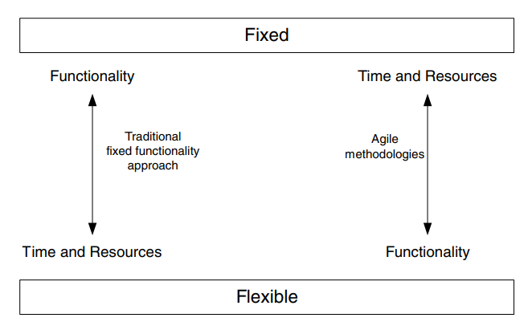
Agile Methods

Slide 14
There are five core methods being worked on and with at
the present time.
eXtreme Programming (or XP),
DSDM – Dynamic system development method
SCRUM
FDD - Feature-Driven Development
Agile Modelling

Slide 15
Extreme Programming (XP): Extreme Programming uses specific practices like pair programming, continuous integration, and test-driven development to achieve these goals. Extreme programming is ideal for projects that have high levels of uncertainty and require frequent changes, as it allows for quick adaptation to new requirements and feedback.
Scrum: Scrum methodology serves as a framework for tackling complex projects and ensuring their successful completion. It is led by a Scrum Master, who oversees the process, and a Product Owner, who establishes the priorities. The Development Team, accountable for delivering the software, is another key player.

Slide 16
Feature-driven development (FDD): FDD approach is implemented by utilizing a series of techniques, like creating feature lists, conducting model evaluations, and implementing a design-by-feature method, to meet its goal. This methodology is particularly effective in ensuring that the end product is delivered on time and that it aligns with the requirements of the customer.
Dynamic Systems Development Method (DSDM): DSDSM methodology is tailored for projects with moderate to high uncertainty where requirements are prone to change frequently. Its clear-cut roles and responsibilities focus on delivering working software in short time frames. Governance practices set it apart and make it an effective approach for teams and projects.

Slide 17
DSDM- Dynamic systems development method
DSDM is An iterative code method within which every iteration follows the 80% rule that simply enough work is needed for every increment to facilitate movement to the following increment. The remaining detail is often completed later once a lot of business necessities are noted or changes are requested and accommodated.

Slide 18
DSDM is based on nine overriding principles, these are:
Active user involvement is imperative.
The team must be empowered to make decisions.
The focus is on frequent delivery of products.
Fitness for business purpose is the essential criterion for acceptance of deliverables.
Iterative and incremental development is necessary to converge on an accurate business solution.
All changes during development are reversible.
Requirements are base lined at a high level.
Testing is integrated throughout the life cycle.
Collaboration and cooperation between all stakeholders is essential.

Slide 19
DSDM Life cycle
The actual DSDM lifecycle is broken down into seven different phases, these are:
Pre-Project Phase
Feasibility Study
Business Case Study
The Functional Model Iteration (FMI)
the Design and Build Iteration (DBI)
the Implementation Phase
the Post-Project Phase.

Slide 20
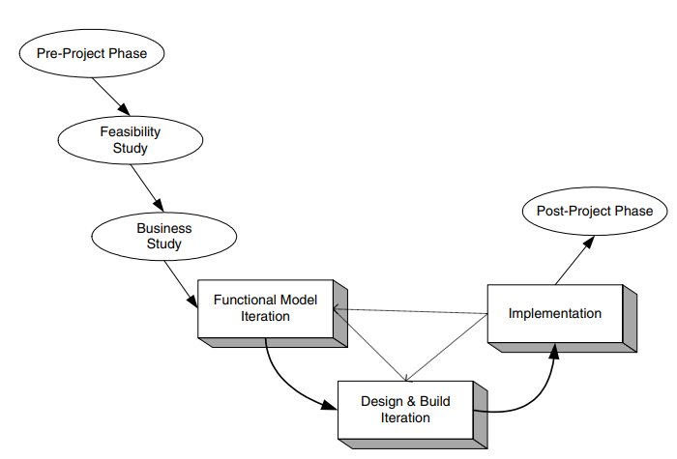

Slide 21
DSDM Life cycle
Feasibility Study: It establishes the essential business necessities and constraints related to the application to be designed then assesses whether or not the application could be a viable candidate for the DSDM method.
Business Study: It establishes the use and knowledge necessities that may permit the application to supply business value; additionally, it is the essential application design and identifies the maintainability necessities for the application .
The Business Study phase of the project should have three outputs
Business Area Definition. Identifies the high-level requirements and provides a process description of the end product.
System Architecture Definition. Sketches out the architecture of end system.
Outline Prototyping Plan. This states the prototyping strategy to be adopted for the development of the end product
Functional Model Iteration:
Analysis of the features to be designed and implemented
It produces a collection of progressive prototypes that demonstrate practicality for the client. The intent throughout this unvarying cycle is to collect further necessities by eliciting feedback from users as they exercise the paradigm.

Slide 22
Design and Build Iteration:
Designing and Building the features to be implemented during this phase. This involves reviewing the designs produced so far, the functional prototypes, as well as the creation of code to implement the required functionality.
The primary output of this state is the tested system
Implementation: It places the newest code increment into the operational surroundings. It ought to be noted that:
(a) the increment might not 100% complete or,
(b) changes are also requested because the increment is placed into place. In either case, DSDM development work continues by returning to the useful model iteration activity.

Slide 23
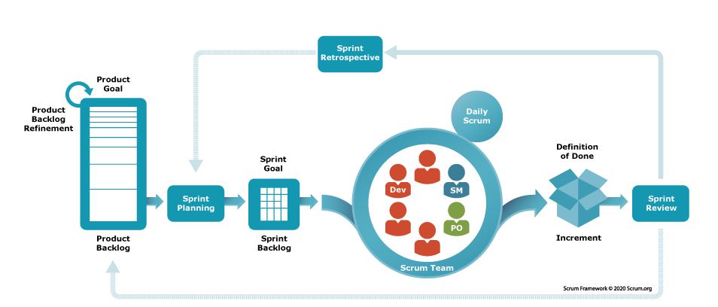
SCRUM
SCRUM aims to manage and control the production of software using iterative, incremental and lightweight processes
Scrum is an approach to managing complicated projects that may have to adapt to changes in scope or requirements. By emphasizing productivity, focus and collaboration

Slide 24
Fundamentals of the Scrum Methodology
The Process
Who’s Who: Scrum Roles
Product Owner
Scrum Master
Development Team
Core Values
As an Agile framework, Scrum shares the values of the Agile Manifesto. But it also creates its own guidelines. These are the five golden rules in Scrum:
Openness
Focus
Courage
Commitment
Respect

Slide 25
The benefits put forward by the proponents of SCRUM are
The management and control of development work in an agile manner.
It explicitly acknowledges that requirements may be changing rapidly within its iterative and incremental approach to product development.
It is possible to still use existing engineering practices within SCRUM (which may help facilitate the introduction of agile methods into an organisation).
It is an inherently team-based approach and helps to improve communications and co-operation.
It scales from small projects up to very large projects.
It helps to identify and then remove any obstacle to the smooth development of the end product

Slide 26
Agile Modelling
Agile Modeling (AM) is a practice-based methodology for effective modeling and documentation.
Rather it is an approach to the modelling aspects of a software development method
Some important concepts:
Model - A model is an abstraction that expresses important aspects of a thing or concepts. Models may be visual (diagrams), non-visual (text descriptions), or executable (working code or equivalent). Models are sometimes called maps or roadmaps within the agile community.
Agile model - Agile models can be something as simple as stickies on a wall, sketches on a whiteboard, diagrams captured digitally via a drawing tool, or detailed models captured using a model-based software engineering (MBSE) tool.
Modeling - Modeling is the act of creating a model. Modeling is sometimes called mapping.
Agile modeling - Agile modeling is modeling performed in a collaborative and evolutionary manner.
Document - A document is a persistent representation of a thing or concept. A document is a model, but not all models are documents (most models are not persistent).
Agile document - Agile documents can be something as simple as point-form notes, detailed text, executable tests, or one or more agile models.

Slide 27
Agile models are good enough when they exhibit the following traits:
Agile models fulfill their purpose.
Agile models are understandable
Agile models are sufficiently accurate
Agile models are sufficiently consistent
Agile models are sufficiently detailed
Agile models provide positive value
Agile models are as simple as possible.

Slide 28
Feature Driven Development
Feature-Driven Development (FDD) is a client-centric, architecture-centric software process.
The big advantage of using a feature-centric approach is managing an agile project, for handling the uncertainties that an agile approach introduces.
A feature is a schedulable requirement associated with the activity used to release it.
These requirements may be user related requirements (i.e., be able to open a bank account)
application behavior requirements (make a backup every 10 min)
internal requirements (provide the ability to turn on debugging for system support).

Slide 29
Thus, a feature mixes units of requirements with units of management. In addition, features should have the following attributes:
Features should be small and “useful in the eyes of system stakeholders.”
Features can be grouped into business-related groupings (called variously feature sets or work packages).
Features focus developers on producing elements within the system that are of tangible benefits to system stakeholders.
Features are prioritized.
Features are schedulable.
Features have an associated (estimated) cost. Can be grouped together into short iterations (possibly as short as two weeks).

Slide 30
Feature-centric management of agile projects offers present a five-step process that outlines how a feature-centric approach works, these five processes are:
Process 1: Develop an overall model of the domain and create an initial feature list.
Process 2: Build a detailed, prioritised feature list.
Process 3: Plan by feature.
Process 4: Design by feature.
Process 5: Build by feature.

Slide 31
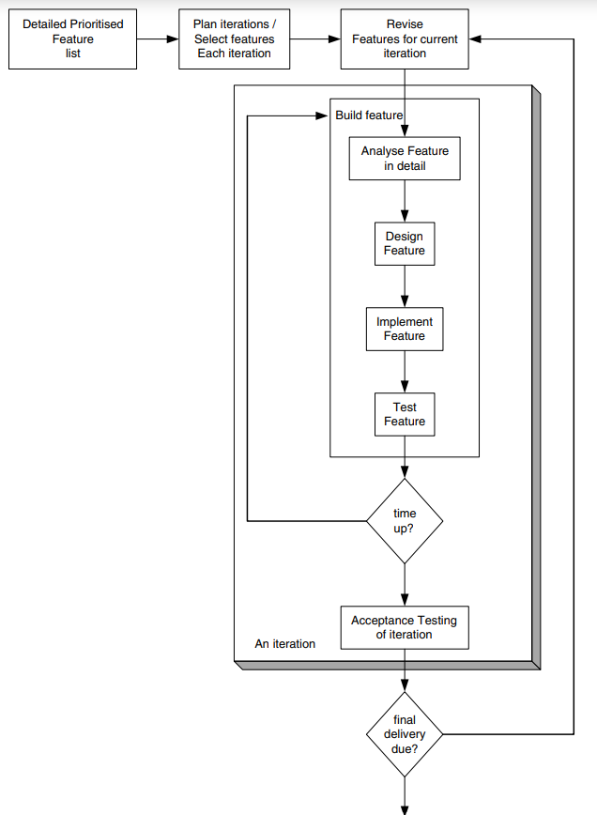

Slide 32
Modelling Misconceptions
Agile methodology can be defined as a software development methodology, which helps the software developers in their process.
Though it is a software development methodology but not only used by developers but everyone engaged in delivering software to their organizations.
For this reason, this methodology is used by a large number of industries and organizations.

Slide 33
10 common misconceptions about Agile and shed light on the accurate understanding of each concept.
Agile Means No Documentation
Agile is Chaotic and Unstructured.
Agile Means No Planning
Agile Equates to Rapid Delivery at the Cost of Quality
Agile Doesn’t Require Leadership or Management
Agile is Only Suitable for Software Development
Agile Means No Set Deadlines
Agile Doesn’t Require Documentation
Agile Teams Don’t Need to Follow Processes
Agile Requires Full Team Consensus

Slide 34
Accuracy and Consistency
Another important aspect of Agile Modelling is that the models need to be only sufficiently accurate and consistent
The model should be comprehensible to their intended audience
The models should be as simple as possible without losing their message. That is, unnecessary details need not be included.

Slide 35
Tools of Misconceptions
UML requires CASE tools
Modelling requires the use of CASE tools
Agile modelers don’t use CASE tools
UML is all you need!
The CASE tool is master

Slide 36
Updating Agile Models
when you should update the models you have created. The general gist of when this should be is “when it hurts not to,” that is when you actually need to.
For example, we create models of what we would implement, these help us to understand what was required and the structure that would be used.
If changes occur to the behavioral aspects of the system and to the structure of the system.
At that point we need not go back and rework the models as they had served their purpose

Slide 37
Sort of Models
Another key idea in Agile Modelling is that content is more important than presentation.
One more point to note about Agile Modelling is that whatever a diagram or diagrams best suit the information you need to present, discussion or understanding should be done.
Also do not feel afraid of mixing diagrams, placing some data modelling on a class diagram, which may well help describe your problem, etc
The key here is to use whatever tools and techniques are available to fit your needs.

Slide 38
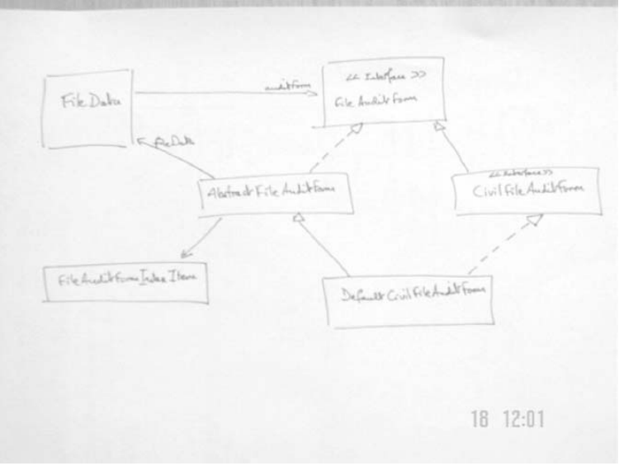

Slide 39
NOTES AND REFERENCES
https://www.simplilearn.com/agile-vs-scrum-article
What is Agile Methodology? – GeeksforGeeks
SCRUM
https://www.wrike.com/blog/fundamentals-of-the-scrum-methodology/
DSDM
Dynamic Systems Development Method (DSDM) – GeeksforGeeks
Example of FDD
https://agilemodeling.com/essays/fdd.htm
Agile misconseptions
https://medium.com/@internationalagilefederation/10-agile-misconceptions-lets-make-them-right-a628d43f85a7#:~:text=Misconception%3A%20Agile%20is%20often%20misunderstood,at%20the%20expense%20of%20quality.
Agile modelling
https://agilemodeling.com/

Slide 40
TWELVE Agile Manifesto Principles
1. Our highest priority is to satisfy the customer through early and continuous delivery of valuable software. You may concentrate on the project's primary goal—delivering what the customer wants, not what you planned—by cutting down on time it takes between the project documentation, reporting to your client, and then obtaining feedback.
2. Welcome changing requirements, even late in development. Agile processes harness change for the customer's competitive advantage. It is time consuming to handle large and complicated work while managing project activities. Therefore, a better strategy is to break the task into manageable, sizeable chunks. In addition, it would be simpler for the team members to see possible bottlenecks and deal with delays if the clients were always kept informed.
3. Deliver working software frequently, from a couple of weeks to a couple of months, with a preference for a shorter timescale. According to the Agile methodology, working software is frequently delivered in a shorter amount of time. Team members must consistently raise their performance standards as a result of this iterative process
. 4. Business people and developers must work together daily throughout the project. In order to ensure that the business and development sides of the project can communicate effectively and, more importantly, collaborate, a bridge between them must be built. To facilitate an intellectual exchange that both parties can agree on, make use of the same tools you would have used in managing remote teams.
5. Build projects around motivated individuals. Give them the environment and support they need, and trust them to get the job done. The project manager must establish a supportive and stimulating environment where team members are free to express their ideas and make recommendations for enhancing the output of the group. This results in a massive improvement in their general performance, eventually aiding the project.
6. The most efficient and effective method of conveying information to and within a development team is face-to-face conversation. Efficient communication among the parties concerned is stressed strongly in the Agile manifesto. Thanks to improvements in communication technologies, it's now simpler. Instead of having a quick conference in the office, all participants can now meet via video conferencing.
7. Working software is the primary measure of progress. Delivering a functional product that pleases the consumer is the single determinant that can guarantee success. Before Agile, numerous success metrics decreased the quality of the finished product.
8. Agile processes promote sustainable development. The sponsors, developers, and users should be able to maintain a constant pace indefinitely. Burnout will occur if you work on a project for a long time. It's inevitable. Avoid placing too much of a workload on your employees. The value of your project will be affected. So, assemble the best team for the job that will work hard but refrain from overworking themselves and endangering the project's quality.
9. Continuous attention to technical excellence and good design enhances agility. Any Agile team's main goal should be to provide value to the client. Therefore, a multi-skilled team that can manage all the project's technical components and offers the chance for continual improvement is crucial.
10. Simplicity — the art of maximizing the amount of work not done — is essential. You should avoid adding extraneous complexity to a project if you want to complete it swiftly. You can accomplish this in various ways, including by using agile tools, which eliminate busywork and offer you more significant influence over all project-related decisions.
11. The best architectures, requirements, and designs emerge from self-organizing teams. Simply said, a self-organized workforce with decision-making autonomy would function better since each team member would be responsible for meeting client expectations rather than a lone project manager.
12. At regular intervals, the team reflects on how to become more effective, then tunes and adjusts its behavior accordingly. Agile techniques are constructed on the notion of iteration, where teams consistently enhance their game by learning from their previous wrongdoings. Project managers should inspire team meetings where everyone evaluates their work and discusses how to develop their management and technical skills

Slide 41
FUNDAMENTALS OF SCRUM…NOTES
The Process
When a customer (internal or external) comes to the team with a certain need, the final product is broken up into individual chunks. (Traditionally this has been a software need, but the process also works for any project that is comprised of multiple stages and pieces, such as a marketing launch.) The pieces are prioritized and tackled in a series of short bursts called sprints. Teams can determine their own sprint length, provided it’s less than 4 weeks (one to two weeks is common). At the end of each sprint, the team delivers a product increment — essentially, a version of the product that could be shipped if necessary. Transparency is a key principle in Scrum, so teams and stakeholders review the results of each sprint together. This ensures everyone's on the same page about priorities and deliverables, and any adjustments can be made right away.
Teams promote internal transparency through daily standups. During these brief, 15-minute meetings, everyone reports what they accomplished yesterday, what they plan to work on that day, and any current “impediments" (factors that are keeping them from working more efficiently). This visibility helps uncover problems and bring them to the forefront quickly, so the team can tackle and overcome them together.
Who’s Who: Scrum Roles
There are three main roles in Scrum: the product owner, the scrum master, and the development team.
Product Owner: Product owners represent the customer's interests. They decide what the team will work on next, so the team's efforts stay focused on high-priority tasks that create the most value. The Kanban product owner must always be available to provide input or guidance to the development team, although it's important to note that product owners are not managers — scrum teams self-organize.
Scrum Master: The Scrum master's #1 goal is to help the development team be self-sufficient. Scrum masters intercept and remove barriers to team progress, and act as a buffer between the team and any outside forces that might interfere with productivity. S/he leads daily standup meetings, so while the product owner is responsible for what the team will produce, the scrum master oversees the how.
Development Team: Development teams are made up of cross-functional team members, so the group has all the necessary skills to deliver the final product. The team focuses on only one project at a time; members don’t multitask or split their efforts between multiple projects. Once the product owner makes an ordered list of what needs to be done, the development team decides how much they can complete in a single sprint and plan accordingly.

Slide 42
Core Values
As an Agile framework, Scrum shares the values of the Agile Manifesto. But it also creates its own guidelines. These are the five golden rules in Scrum:
Openness: Scrum sees collaboration as the most effective way to create the best possible product. So teamwork and transparency are essential. Rather than anxiously downplaying problems, Scrum team members are open about their progress and any roadblocks they encounter.
Focus: With Scrum, multitasking is out. Since productivity is key, splitting the team’s attention across multiple projects, or redirecting their efforts mid-sprint by shifting priorities, is avoided at all costs. Instead, teams concentrate on the task at hand for the highest velocity and best quality product.
Courage: Teams must have the tenacity to commit to an ambitious (but attainable) amount of work for each sprint. Scrum masters must also be able to stand up to stakeholders if necessary, and the product owner must guide the development team with authority.
Commitment: Each sprint is itself commitment: teams must agree on what they’re going to accomplish and stick to it. This value is reflected in each team’s unique “Definition of Done,” a list of criteria to determine whether a feature or deliverable is truly finished — that it’s not only fully functional, but meets the team’s standards for quality.
Respect: In the service of true collaboration, roles and responsibilities are transparent. Each member of the team is respected equally, regardless of job description, seniority, or status. The development team must honor the product owner’s authority in deciding what the team works on, and the product owner needs to respect the team’s need follow whatever work process is best for them.

Slide 43
We can elaborate on that by considering an iterative feature based lifecycle. This is presented in Figure 2.4. In the diagram above, the flow illustrates the following steps:
1. First identify a prioritised feature list. This can be done by considering the systems’ requirements. These can be produced in whatever manner is appropriate. For example, through use cases, a formal requirements specification or user stories. What is required is that they are elaborated sufficiently to allow prioritisation and an initial cost estimate to be associated with them.
2. This initial feature list is then used to create a plan of the iterations to be undertaken. Each iteration should have one or more features associated with it and should not be too long. Each iteration should have a timebox associated with it that specifies when it starts and when it finishes.
3. Before each iteration starts, the iteration should be planned in detail. This involves determining which features are still relevant for that iteration, any revised priorities and an ordering to the features.
4. Once a iteration starts, each iteration is addressed in turn based on their priorities. At any one time, one or more features will be worked on depending on the size of the feature and the resources available (note that no assumption is made here about how many people will be needed to implement a feature, there could be one developer perfeature, two perfeature or variable depending upon the step within the feature that is currently being addressed).
5. The iteration stops when the timebox finishes. At the end of the iteration, the current version of the software is tested to ensure it does what it should
6. If this is the final iteration, then the final version of the system is delivered (if it is not the final iteration, then the current system may still be delivered to end users for early and frequent feedback). This is possible as each feature should be useful in the eyes of the various project stakeholders in their own right.

Slide 44
Tool Misconceptions
At this point,itisworthwhile considering somemisconceptions andmyths relating to the use of tools, modelling and UML.
UML requires CASE tools. This is certainly not true – I can draw a UML diagram freehand on paper, use a simple drawing package such as Paint or indeed with a tool such as Together. It may well be true that to strictly adhere to the UML notation it is easier to use something that knows about UML (and Visio might be such a tool). It may also be true that if you want to generate code from the UML diagrams, using a CASE tool such as Rose or Together makes life easier. But it is not a pre-requisite.
2. Modelling requires the use of CASE tools. An extension of the last point is that if you are going to create models as part of your design you need a CASE tool that can manage, manipulate, cross reference, etc., your models. While these features may well be useful, they are not necessary. I can (and indeed have) used simpler tools such as Visio to perform all the modelling necessary for the design of a system. Obviously, the larger the system and the larger the amount of modelling performed, the better a CASE tool may be.
3. Agile modellers don’t use CASE tools. This is a common misconception by those starting with Agile Modelling. This is partly due to the emphasis of Agile Modelling on using the simplest appropriate tool and if that tool is a white board or a piece of paper, use it. The key word here is appropriate. If I need to work something through with one of my colleagues, we might well use a white board or a piece of paper and not worry too much about the accuracy of the UML notation being used. If however, I am trying to describe a complex structure that will need to be referenced by a variety of developers, possibly in multiple locations, then a CASE tool might well be the most appropriate.
4. UML is all you need! Some take the view that UML is all you need in terms of notation – if you can’t do it in UML (aka the design tool you are using), then it is either not relevant to an object-oriented system or not important enough to document. This is not true. There are many aspects of a software project that you may wish to document, but do not fit within the remit of a UML diagram, for example, GUI storyboarding, data modelling, etc.
5. The CASE tool is master. This is more a perception than a misconception. It is a perception because users often feel that they are battling with the CASE tool and that they have to work in the way prescribed by the CASE tool. Certainly, I know that some of the colleagues I have worked with over the years have an almost irrational hatred against one well known CASE tool because of the way it forces them to work. Some of this can be overcome with training and some by choosing a suitable tool. The important thing is that the CASE tool should not be the master but the servant. It should help you with your work and not hinder it. Thus, finding an appropriate tool (or tools) is important. For example, in one case Together proved to be particularly well suited to the organisations way of working and to the developers experience and background

Slide 45
Updating Agile Models
Finally, we come to the question of when you should update the models you have created. The general gist of when this should be is “when it hurts not to,” that is when you actually need to. What does this mean? Take, for example, the case on a recent project I was involved with. On that project, we created models of what we would implement, these helped us to understand what was required and the structure that would be used. However, for various memory and performance reasons, it was found that the implementations had to change to try and reuse as many Java Swing components as possible and to cache any data not actually being displayed. This necessitated quite a few changes to the behavioural aspects of the system and some changes to the structure of the system. However, at that point we did not go back and rework the models as they had served their purpose – they had helped us to understand the requirements and how the system should be structured (in addition, they still gave a flavour of the 3· Agile Modelling 43 system). If those models were never needed again, reworking them would have been a waste. Some 6 months later, this aspect of the system was to be updated. It was at this point that a software engineer updated the models by reverse engineering the classes. He also worked through the code to update the behavioural aspects of the model. This had two effects: first, the models were updated in a timely fashion, and second, the software engineer involved gained a detailed understanding of this part of the system before he commenced further design. In addition, some models may never be required again and can be thrown away. For example, the hand-drawn models used to allow myself and a colleague to understand how two areas of the system will interact do not necessarily need to be saved for posterity. The existing models may be more than suffice. Therefore, the hand-drawn model (created to help our understanding) can be thrown away. This means that it does not need to be maintained, fully documented, recorded, reviewed, etc. This can be taken further for more formal models, created using tools such as Rose. However, I tend towards caution and tend to feel that if the model was established enough to have been created in a CASE tool, then it should at least be stored in a version control tool (such as CVS or SCCS) so that it can be retrieved if necessary at a later date (otherwise the effort used to create the model may be lost altogether!)

